Slide 1
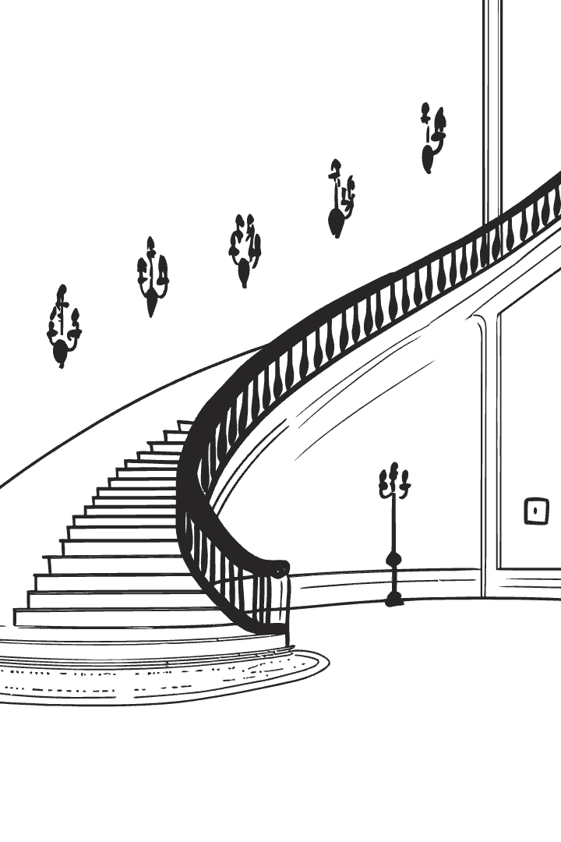
Advanced Programming Techniques
A deep dive into software architecture, design patterns, and best practices
Adrian Buturuga
Principal Development Consultant @ Endava

Slide 2
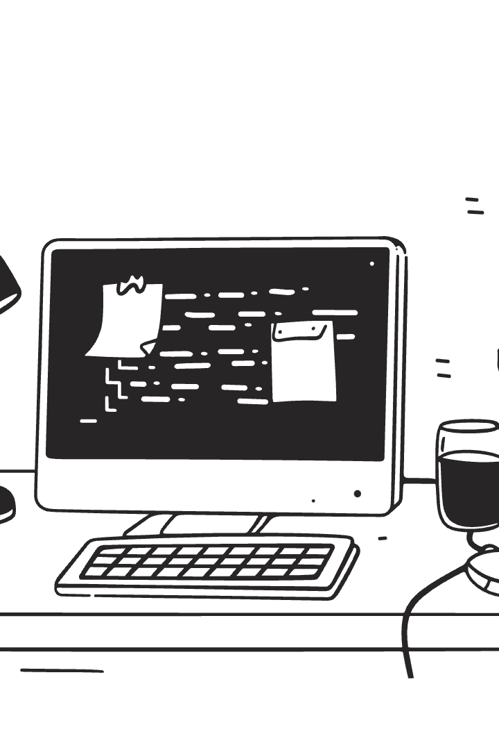
Course Overview
1
Objective:
2
Topics covered:
Learn advanced software development techniques for scalable and maintainable applications
Software design principles
Object-oriented design patterns
Enterprise integration patterns
Hands-on development of real-world solutions
3
Assessment:
Final Written Exam: Applied exercises based on the course curriculum

Slide 3
Course Outline
Week 1:
1
Introduction to Software Design & SOLID Principles
2
Week 2-5:
Object-Oriented Design Patterns
Creational Patterns (Factory, Singleton, Builder)
Week 6-9:
3
Structural Patterns (Adapter, Decorator, Composite)
Enterprise Integration Patterns
Behavioral Patterns (Strategy, Observer, Command)
Messaging & Event-Driven Architecture
Microservices Communication Strategies
4
Week 10-12:
Advanced Architectural Patterns
Domain-Driven Design
Week 13-14:
5
Hexagonal Architecture
Exam Preparation & Case Studies
Event Sourcing & CQRS

Slide 4

Why This Course Matters?
Modern software needs scalability, maintainability, and flexibility
Poor software design leads to:
Well-structured software ensures:
Difficult-to-maintain code
✅ Readability & maintainability
Increased technical debt
✅ Easy extension & modification
Performance and scalability issues
✅ High reusability & testability

Slide 5
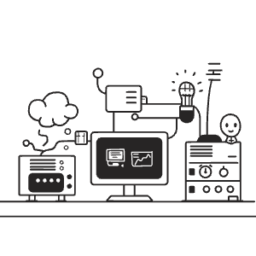
Software Design Challenges
Common Problems:
Solution:
❌ Code that is too complex to understand
Apply SOLID Principles and Design Patterns
❌ Modifications break existing functionality
❌ Large classes that handle too many responsibilities
❌ Tight dependencies that make testing difficult

Slide 6
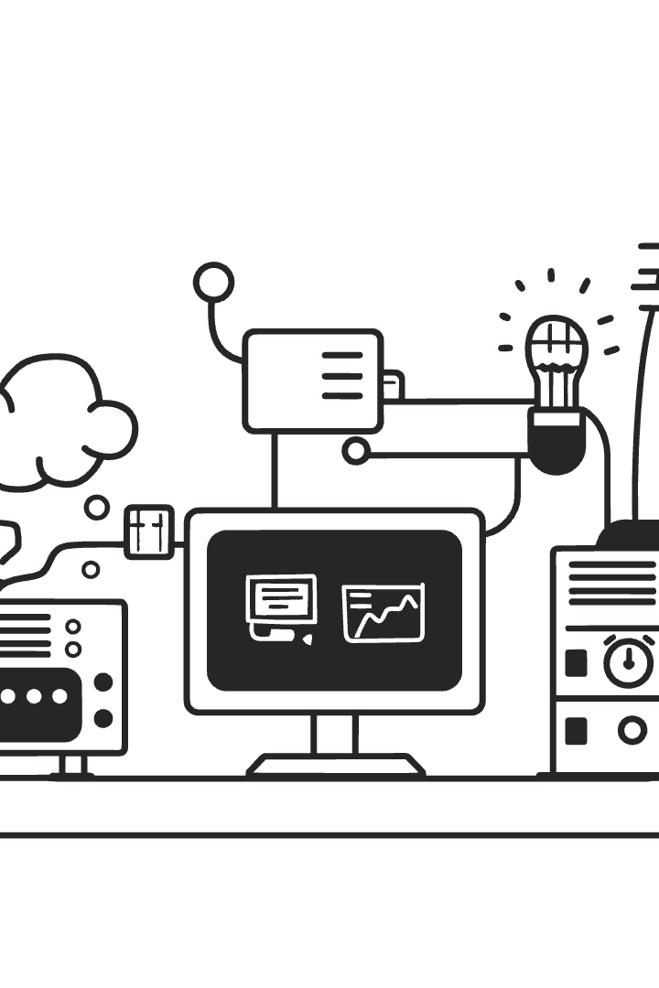


Introduction to SOLID Principles
Definition:
Benefits of applying these principles:
A set of five principles to design maintainable and scalable object-oriented software
✅ Reduces complexity
✅ Improves code reusability
✅ Simplifies testing

Slide 7
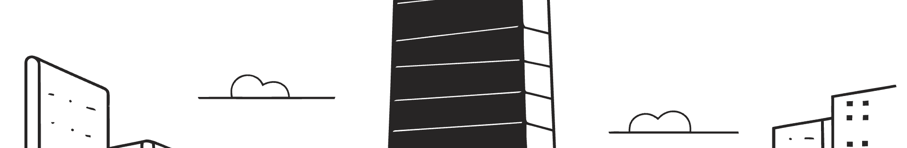
SOLID Principles Overview
Principle
Description
Single Responsibility Principle
A class should have only one responsibility
Open/Closed Principle
Software should be open for extension, but closed for modification
Liskov Substitution Principle
Subclasses should be substitutable for their base classes
Interface Segregation Principle
Interfaces should be small and specific
Dependency Inversion Principle
Depend on abstractions, not concrete implementations

Slide 8
Single Responsibility Principle
A class should have one and only one reason to change
Bad Example:
✅ Fix: Separate Concerns
class Order {
public void processOrder() {
System.out.println("Processing order...");
saveToDatabase();
sendEmail();
}
private void saveToDatabase() {
System.out.println("Saving order to DB...");
}
private void sendEmail() {
System.out.println("Sending confirmation email...");
}
}
interface OrderRepository {
void save(Order order);
}
interface NotificationService {
void sendConfirmation(Order order);
}
class Order {
private OrderRepository orderRepository;
private NotificationService notificationService;
public Order(OrderRepository orderRepository, NotificationService notificationService) {
this.orderRepository = orderRepository;
this.notificationService = notificationService;
}
public void processOrder() {
System.out.println("Processing order...");
orderRepository.save(this);
notificationService.sendConfirmation(this);
}
}
🚨 Problem: ❌ The Order class has multiple responsibilities.

Slide 9
Open/Closed Principle
✅ Fix: Use Abstraction & Polymorphism
Software should be open for extension but closed for modification
Bad Example:
interface Payment { void process(); } class CreditCardPayment implements Payment { public void process() { System.out.println("Processing Credit Card Payment..."); } } class PayPalPayment implements Payment { public void process() { System.out.println("Processing PayPal Payment..."); } } class PaymentProcessor { public void processPayment(Payment payment) { payment.process(); } }
class PaymentProcessor { public void processPayment(String type) { if (type.equals("CreditCard")) { System.out.println("Processing Credit Card Payment..."); } else if (type.equals("PayPal")) { System.out.println("Processing PayPal Payment..."); } } }
🚨 Problem: ❌ If we need to add a new payment method (e.g., Bitcoin), we must modify this class.
✅ Now we can add new payment types without modifying existing code!

Slide 10
Liskov Substitution Principle
Objects of a superclass should be replaceable with objects of a subclass without affecting the correctness of the program.
Problem
Solution
Subclasses should be substitutable for their base classes without breaking functionality.
class Bird {
// Common bird behaviors
public void eat() {
System.out.println("Eating...");
}
}
interface Flyable { void fly(); }
class Sparrow extends Bird implements Flyable {
public void fly() {
System.out.println("Flying...");
}
}
class Penguin extends Bird {
// No fly method - correctly doesn't claim to support flying
public void swim() {
System.out.println("Swimming...");
}
}
When a subclass doesn't support the behavior expected of its parent class, it violates LSP. For example, a penguin can't fly, breaking the base `Bird` class's expected `fly()` behavior.
class Bird { public void fly() { System.out.println("Flying..."); } } class Penguin extends Bird { @Override public void fly() { throw new UnsupportedOperationException("Penguins can't fly!"); } } // This will crash at runtime: Bird bird = new Penguin(); bird.fly(); // Throws exception!
🚨 This breaks LSP because we can't substitute a Penguin for a Bird without breaking the program.
✅ Now we can use all birds interchangeably for bird behaviors, and only expect flying from Flyable birds.

Slide 11
Interface Segregation Principle
Bad Code Example
Fixed Code Example
Worker interface has multiple responsibilities: work() and eat().
Separate concerns by splitting the Worker interface.
A robot should implement work(), but not eat().
HumanWorker implements both work and eat behaviors.
interface Worker { void work(); void eat(); } class RobotWorker implements Worker { public void work() { ... } public void eat() { throw new UnsupportedOperationException(); } }
RobotWorker only implements work behavior.
interface Workable { void work(); } interface Eatable { void eat(); } class RobotWorker implements Workable { public void work() { ... } }
This forces unrelated functionality.
Each class only implements relevant interfaces.

Slide 12
Liskov Substitution Principle vs. Interface Segragation Principle
Liskov Substitution Principle
Interface Segregation Principle
Main Concern
Ensuring that subtypes can replace their base types without altering expected behavior.
Avoiding forcing classes to implement methods they do not use.
Problem It Solves
Prevents subclasses from modifying or breaking inherited behavior in a way that makes them unusable as a true substitute for their parent class.
Prevents bloated interfaces that require implementing unrelated or unnecessary methods.
Common Violation Example
A subclass overrides a method and throws an exception because it does not support the behavior (e.g., `Penguin` inheriting `Bird.fly()`).
A class is forced to implement methods it does not need because an interface contains too many responsibilities (e.g., `RobotWorker` forced to implement `eat()`).
Fix
Restructure the hierarchy to avoid forcing invalid behavior on subclasses (e.g., separating `FlyingBird` and `Penguin`).
Split large interfaces into smaller, more specific ones so that classes only implement what they need.
LSP Violation
ISP Violation
Light bulb socket needs a light bulb, not a plug 💡. Substituting objects should not break expectations.
Steering wheel 🚗 shouldn't control brakes. Interfaces should not force unnecessary features.

Slide 13
Dependency Inversion Principle
Bad Code Example
Fixed Code Example
A high-level module directly depends on a low-level module.
Introduce an interface that both MySQL and other databases can implement.
This creates tight coupling. It makes changing the database hard.
This abstraction lets us replace MySQLDatabase easily.
class MySQLDatabase { public void saveOrder(String order) { System.out.println("Saving order to MySQL: " + order); } } class OrderProcessor { private MySQLDatabase database; public OrderProcessor() { this.database = new MySQLDatabase(); // Direct dependency } public void process(String order) { System.out.println("Processing order: " + order); database.saveOrder(order); } }
interface Database { void saveOrder(String order); } class MySQLDatabase implements Database { public void saveOrder(String order) { System.out.println("Saving order to MySQL: " + order); } } class OrderProcessor { private Database database; public OrderProcessor(Database database) { // Depend on abstraction this.database = database; } public void process(String order) { System.out.println("Processing order: " + order); database.saveOrder(order); } }

Slide 14
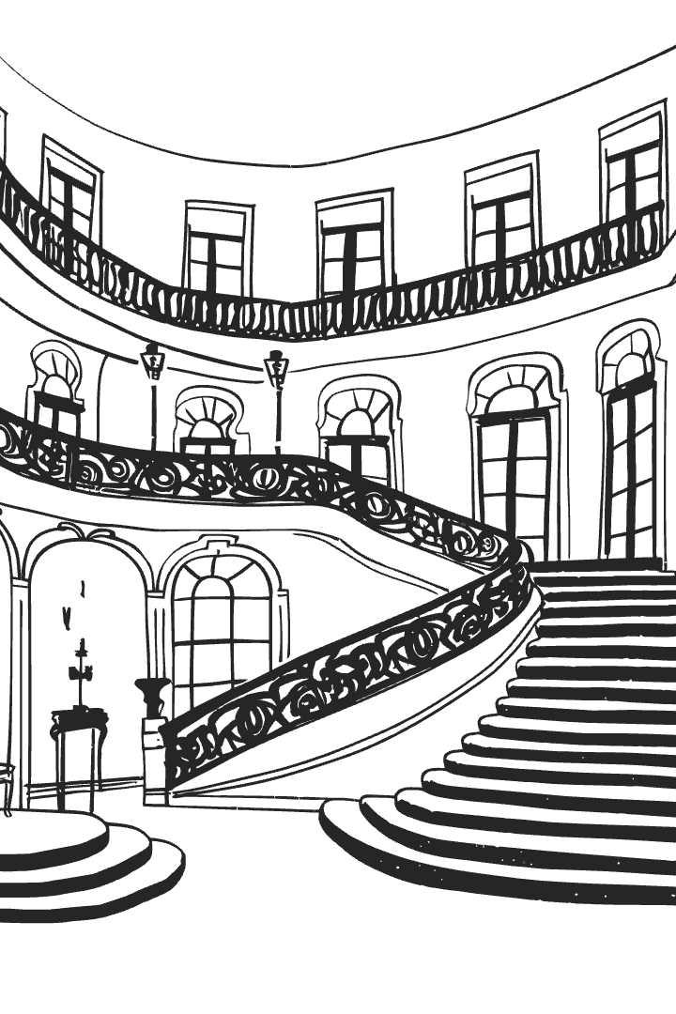
Introduction to Design Patterns
1
Definition:
"Reusable solutions to common software problems"
2
Why use them?
✅ Improve code maintainability
✅ Increase software scalability
✅ Reduce development effort

Slide 15
Purpose & Use Cases of Design Pattern Categories
Creational Patterns
Structural Patterns
Behavioral Patterns
Abstract object instantiation. Promotes flexibility and reuse with centralized object creation.
Define class and object relationships for efficiency. Ensures component structure.
Govern object interactions with loose coupling, promoting separation of concerns and maintainability.
Factory Method
Adapter
Singleton
Decorator
Strategy
Builder
Composite
Observer
Use when class is determined at runtime or to construct complex objects.
Use when adapting interfaces, extending functionality, or treating objects as one.
Command
Use when selecting algorithms, reacting to state changes, or encapsulating requests.

Slide 16
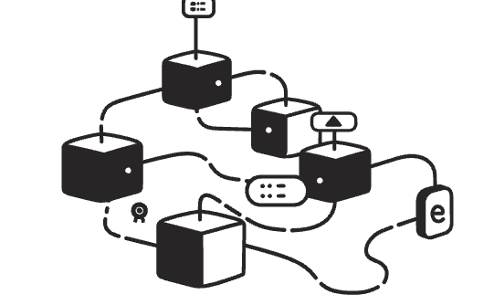


Summary & Next Course
Key Takeaways
Next Week
Practical Application
✅ SOLID principles improve maintainability
Creational Design Patterns: Singleton, Factory, Builder
We'll implement these concepts in real-world scenarios through guided exercises and collaborative problem-solving.
✅ Design Patterns offer reusable solutions
Hands-on coding session
✅ Applying both ensures scalable software

